Slide 1

Ripples of Precision: Crafting a Crystal-Clear Tomorrow with an AI-powered Water Quality Classification Mode
Submitted By:
Name: Soumyajit Biswas
Roll: A23044

Slide 2
CONTENTS
Objective
Data Description
Eda
Feature Engineering
Instructions for use.
Model Fitting
Model Evaluation
Comparison
Conclusion

Slide 3

Objective
The "Water Quality Classification Model" project aims to develop a precise machine learning model for accurate classification, enabling early detection of contaminants and timely intervention. The system will integrate predictive analytics for forecasting, feature a user-friendly interface, and establish real-time monitoring for continuous assessment. Spatial analysis will identify regional patterns, and diverse data sources will enhance accuracy. The model will be flexible and customizable for different environments, aligning with regulatory standards through collaboration with authorities. Educational outreach will raise community awareness, and continuous improvement mechanisms will ensure responsiveness to user feedback. The project also explores cost-effective solutions, aiming for broad accessibility and sustainable water management practices.

Slide 4
Introduction
Embarking on the frontier of environmental stewardship, the 'Water Quality Classification Model' project seeks to revolutionize the management of our precious water resources. This initiative endeavors to harness the power of machine learning for the accurate classification of water quality, facilitating early detection of contaminants and timely intervention. By integrating predictive analytics, real-time monitoring, and spatial analysis, the project aspires to provide a comprehensive solution that not only identifies regional patterns but also aligns with regulatory standards through collaboration with authorities. Through user-friendly interfaces, educational outreach, and continuous improvement mechanisms, the project aims to empower communities with knowledge, fostering sustainable water management practices and ensuring the availability of clean and safe water for generations to come.

Slide 5
Why is this problem useful
The water quality classification problem is crucial for safeguarding public health, preserving ecosystems, and enabling sustainable resource management. Accurate assessments help prevent waterborne diseases, protect aquatic life, and support responsible water allocation. Early detection facilitates timely intervention, reduces environmental impact, and ensures compliance with regulatory standards. Community awareness and empowerment, along with the application of advanced technologies, contribute to global sustainability goals and foster innovation in environmental management. Solving this problem directly addresses fundamental aspects of human well-being, environmental resilience, and responsible resource utilization.

Slide 6

Data understanding
pH: The pH level of the water.
Hardness:Water hardness, a measure of mineral content.
Solids: Total dissolved solids in the water.
Chloramines: Chloramines concentration in the water.
Sulfate:Sulfate concentration in the water.
Conductivity: Electrical conductivity of the water.
Organic carbon: Organic carbon content in the water.
Trihalomethanes: Trihalomethanes concentration in the water.
Turbidity: Turbidity level, a measure of water clarity.
Potability:Target variable; indicates water potability with values 1 (potable) and 0 (not potable).

Slide 7
Data Exploration
LOAD DATA
DATA WRANGLING
PIPELINES
Data loaded into collections using pymongo for directly storing it in the cloud/local database Basic EDA performed using various commands
Data cleaning & wrangling using Pyspark
Mean summary for numerical column
No. of stops during various times of day
Categorical distributions for various categorical columns
Using String Indexer , one hot encoding & vector assembler
Building pipelines for pre-processing including stages for String Indexer , one hot encoding & vector assembler
Building pipelines for both Machine learning models (RF & DT)
The pipelines for models have stages for fitting , testing & evaluating the models

Slide 8
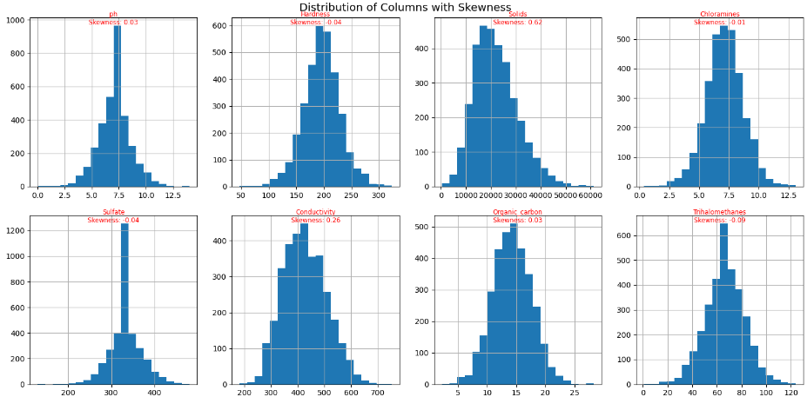
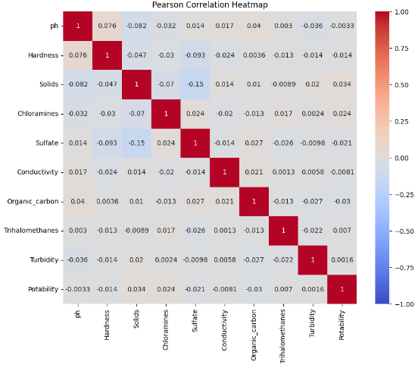
EDA

Slide 9
Flow
The accuracy is evaluated is compared for both models and any observations regarding the model (fit, bias, variance) interpreted
Dropping irrelevant columns, treating null values. Post this columns are indexed, encoded & vectorized into a feature column
Load the data using Pymongo after establishing a connection & creating Database
Loading data
EDA
Pre-Processing
Pipelines & Models
Interpretation
Summarizing various attributes using Pymongo methods for both numerical & categorical columns
Pipelines built using Pipelines module from Mllib in Pyspark for indexing, vectorizing etc apart from models(train, test & evaluate

Slide 10
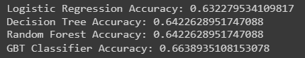
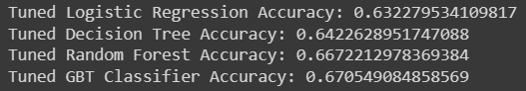
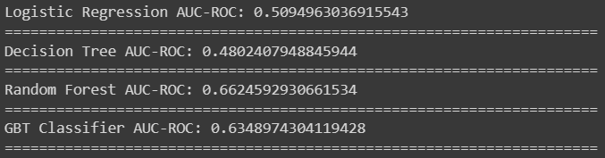
Results
Before Tuning
After Tuning

Slide 11
Achievments
Undertaking a water quality classification project within the realm of Machine Learning (ML) offers several achievements that leverage the capabilities of ML techniques:
Increased Accuracy and Efficiency:
- ML models enhance the accuracy of water quality classification by efficiently processing and analyzing vast datasets, identifying patterns, and making precise predictions.
Early Detection and Predictive Analytics:
- ML algorithms enable early detection of water quality issues by learning from historical data, and they support predictive analytics, forecasting potential contaminant levels and changes in water quality over time.
Customization for Diverse Environments:
- ML models can be tailored to specific environmental conditions, allowing for customization and adaptation to diverse ecosystems and water bodies.
Continuous Improvement and Learning:
- ML models can be designed for continuous improvement, with the ability to learn from feedback and adapt to emerging patterns, ensuring sustained accuracy and relevance.
Identification of Hidden Patterns:
- ML algorithms can uncover hidden patterns and correlations in data that may not be apparent through traditional analysis methods, enhancing the understanding of factors influencing water quality.
Enhanced Decision-making for Remediation:
- ML-driven insights assist in formulating effective strategies for remediation efforts, guiding authorities and stakeholders in prioritizing interventions based on the severity and nature of water quality issues.
Facilitation of Research and Innovation:
- ML applications in water quality projects contribute to scientific research and innovation in environmental monitoring, setting the stage for advancements in machine learning techniques tailored to environmental science.

Slide 12
Thank You

